Slide 1
NLP, Word embedding

Slide 2
Natural Language Processing (NLP)
NLP stands for Natural Language Processing.
It is a branch of Artificial Intelligence (AI) that helps computers understand, interpret, and generate human language.
Goal: Enable communication between humans and machines using natural language.

Slide 3
Why NLP is Important
Automates text and speech-based tasks.
Enhances user experience in virtual assistants.
Helps analyze large volumes of textual data efficiently.
Used in real-world applications like translation and chatbots.

Slide 4
Applications of NLP
Machine Translation: Google Translate.
Chatbots and Virtual Assistants: Siri, Alexa, ChatGPT.
Sentiment Analysis: Understanding opinions from social media.
Text Summarization: Condensing long documents.
Speech Recognition: Voice commands in mobile devices.

Slide 5
Key Components of NLP
Morphological Analysis: Word structure.
Syntax Analysis: Grammar and sentence formation.
Semantic Analysis: Understanding meaning.
Pragmatics: Contextual meaning and intent.
Discourse Integration: Linking multiple sentences together.

Slide 6
NLP Pipeline
Text Collection
Tokenization (Splitting sentences into words)
Stop Word Removal (Removing common words like 'the', 'is')
Stemming/Lemmatization (Reducing words to root form)
Feature Extraction (TF-IDF, Word Embeddings)
Model Training (Classification or Generation)

Slide 7
Techniques Used in NLP
Rule-based Methods: Grammar and dictionaries.
Statistical Models: Hidden Markov Models, N-grams.
Machine Learning Models: Naïve Bayes, SVM.
Deep Learning Models: RNN, LSTM, Transformers.

Slide 8
Word Representation
Bag of Words (BoW): Frequency-based representation.
TF-IDF: Importance-based representation.
Word Embeddings: Dense vector representations (Word2Vec, GloVe).

Slide 9
Recent Advances in NLP
Introduction of Transformers (Vaswani et al., 2017).
Contextual understanding using BERT and GPT models.
Improved text understanding, summarization, and generation.

Slide 10
Word Embeddings in NLP
Word Embeddings are numeric representations of words in a lower-dimensional space, that capture semantic and syntactic information.
They play a important role in Natural Language Processing (NLP) tasks.
Method of extracting features out of text so that we can input those features into a machine learning model to work with text data.
It allows words with similar meanings to have a similar representation. Thus, Similarity can be assessed based on Similar vector representations.
High Computation Cost: Large input vectors will mean a huge number of weights. Embeddings help to reduce dimensionality.
Preserve syntactical and semantic information.
Some methods based on Word Frequency are Bag of Words (BOW), Count Vectorizer and TF-IDF.

Slide 11
Need for Word Embedding
To reduce dimensionality.
To use a word to predict the words around it.
Helps in enhancing model interpretability due to numerical representation.
Inter-word semantics and similarity can be captured.

Slide 12
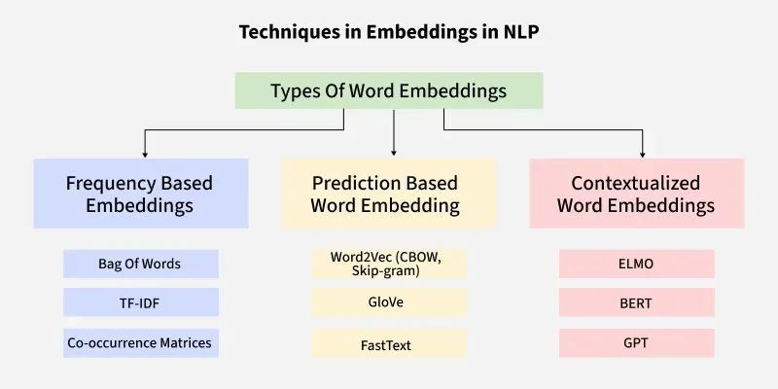
Approaches for Text Representation

Slide 13
Bag of Words (BoW)
The Bag of Words model represents text as a collection (or “bag”) of its words, ignoring grammar and word order but keeping the frequency of each word.
It’s one of the simplest and most commonly used methods for text representation in Natural Language Processing.

Slide 14
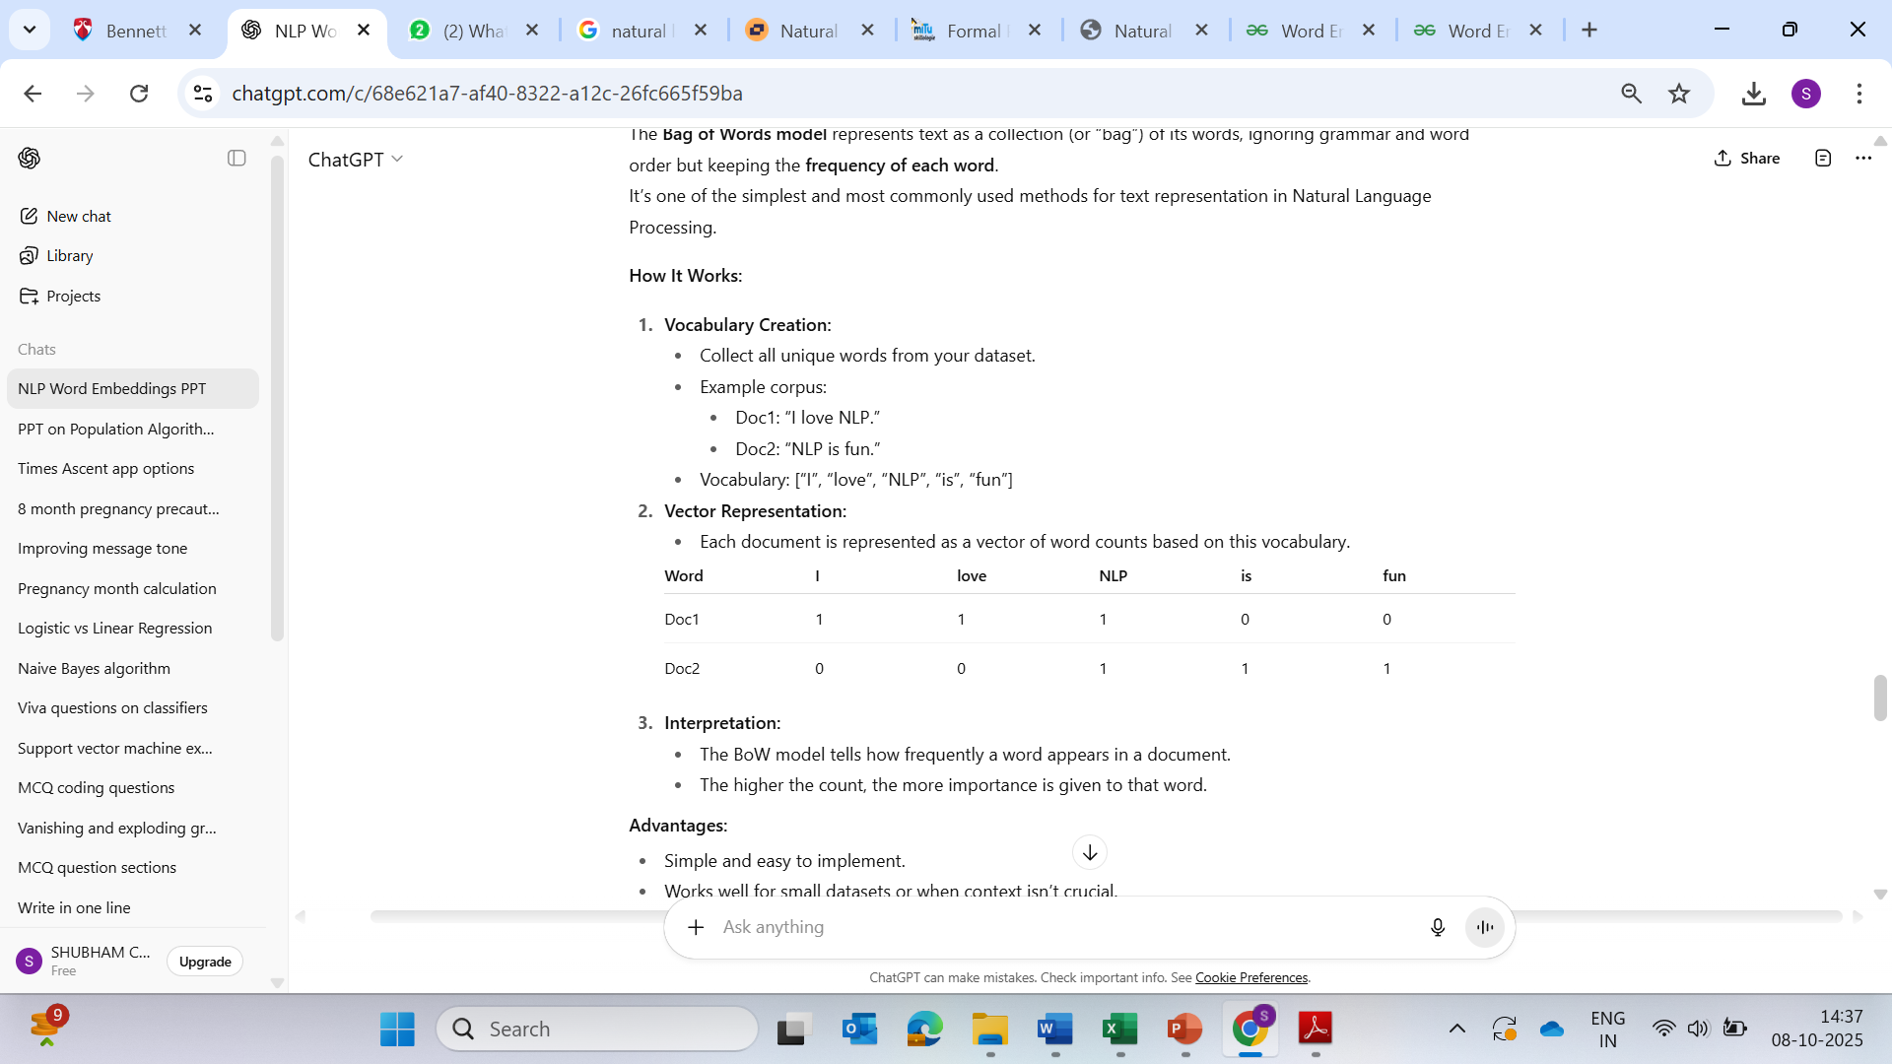
How It Works

Slide 15
TF-IDF (Term Frequency–Inverse Document Frequency)
TF-IDF improves upon BoW by not only considering how often a word appears in a document (term frequency) but also how unique or rare that word is across all documents (inverse document frequency).
This helps give less weight to common words and more weight to rare, informative words.

Slide 16
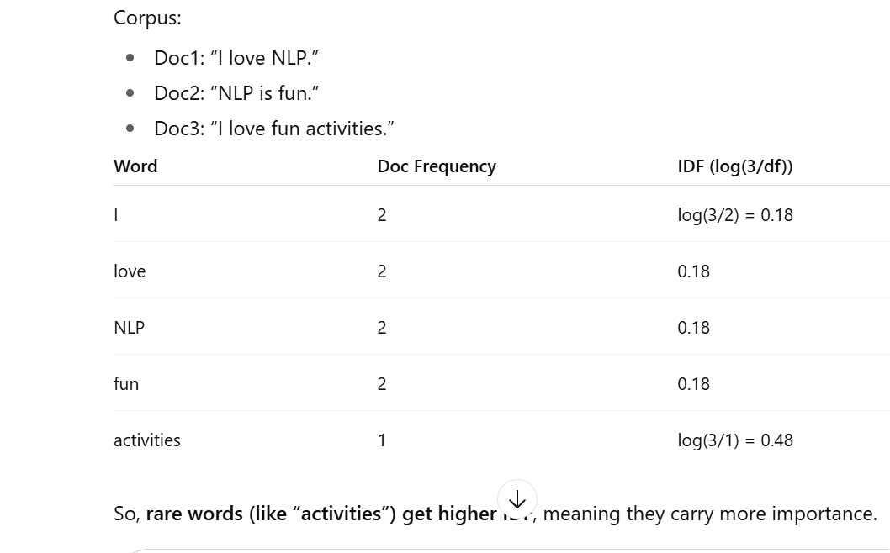
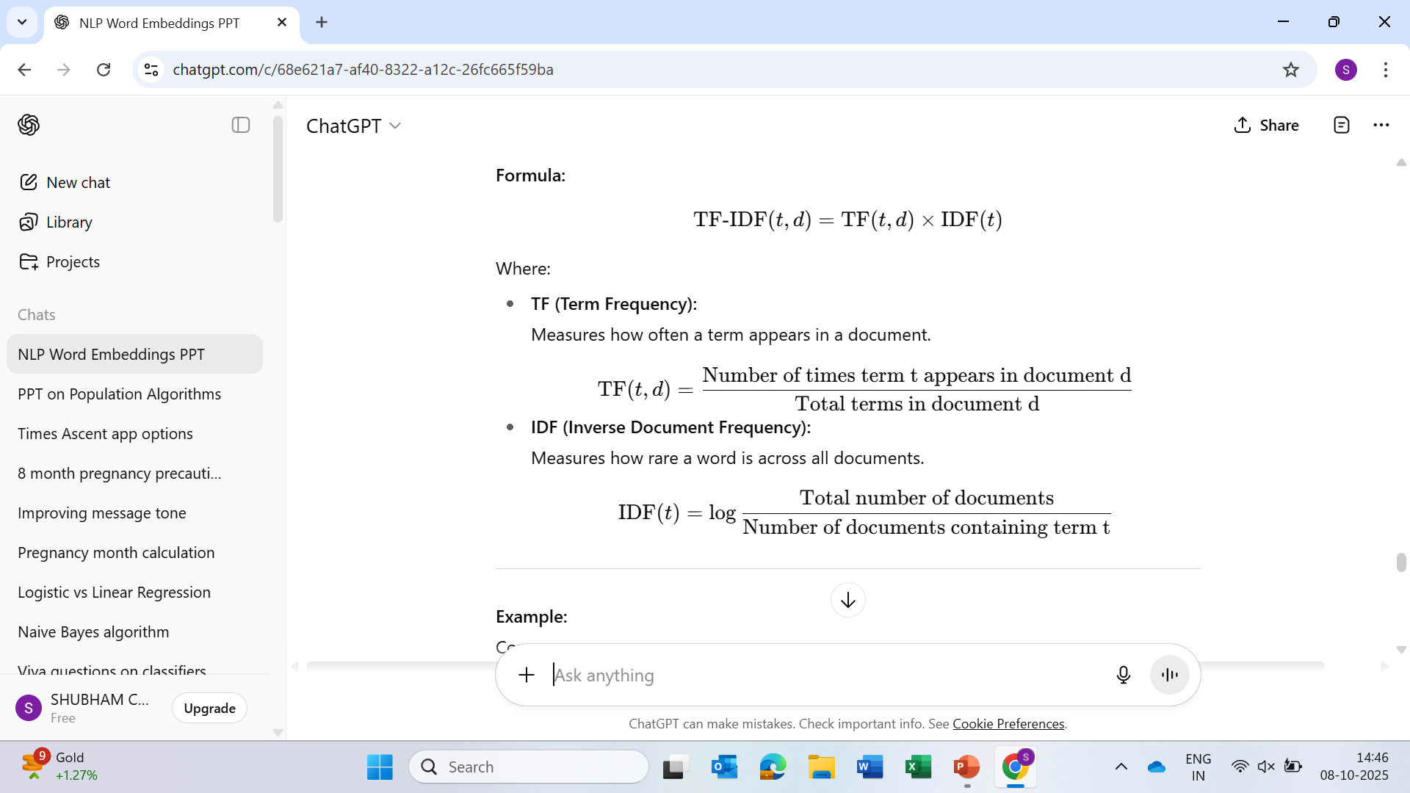
Example

Slide 17
Introduction to Transformers
Introduced by Vaswani et al., 2017 in the paper “Attention is All You Need.”
Marked a major shift from RNNs and LSTMs to a self-attention-based model.
Key innovation: Parallel processing of all words in a sentence, rather than sequentially.
Widely used in modern NLP models such as BERT and GPT.

Slide 18
Key Idea — Attention Mechanism
Attention allows the model to focus on relevant words in a sentence while processing each word.
Example:
In “The cat sat on the mat,”
  while processing “sat”, attention focuses on “cat”.
Helps model learn contextual relationships between all words, regardless of position.

Slide 19
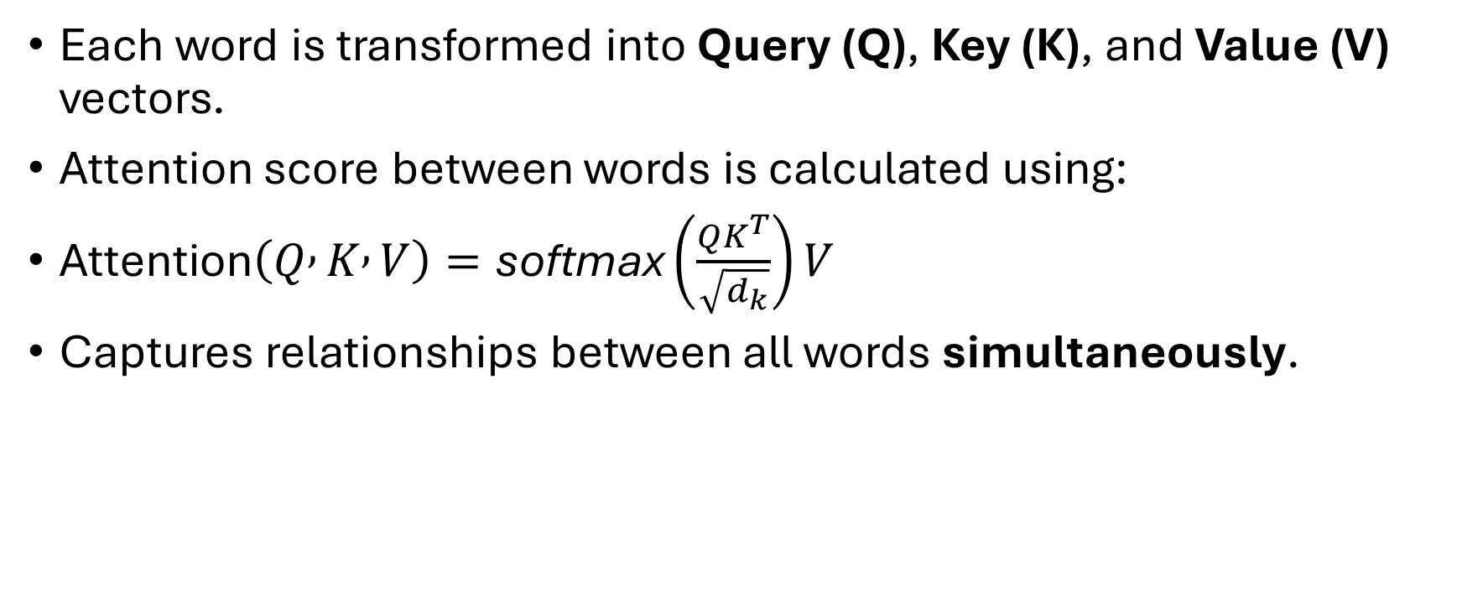
Self-Attention in Transformers
Each word is transformed into Query (Q), Key (K), and Value (V) vectors.
Attention score between words is calculated using:
$\text{Attention}\left(Q , K , V\right)=\text{softmax}\left(\frac{QK^{T}}{\sqrt{d_{k}}}\right)V$
Captures relationships between all words simultaneously.

Slide 20
Transformer Architecture Overview
Two main parts:
Encoder: Processes input text.
Decoder: Generates output (e.g., translation).
Both contain multiple layers of:
Multi-Head Self-Attention
Feedforward Neural Network
Layer Normalization & Residual Connections

Slide 21
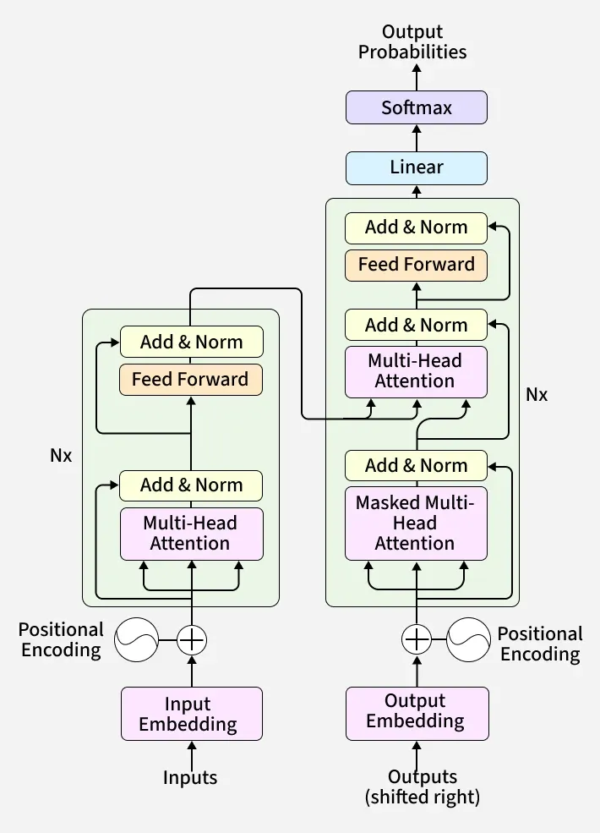

Slide 22
Encoder and Decoder Structure
Encoder:
Input Embedding → Positional Encoding → Multi-Head Attention → Feedforward → Output.
Decoder:
Masked Self-Attention → Encoder-Decoder Attention → Feedforward → Output logits.
Enables simultaneous understanding and generation of sequences.

Slide 23
Positional Encoding
Since Transformers process all words at once (no sequence order),
Positional Encoding adds order information to embeddings.
Uses sine and cosine functions to encode position of each word in the sequence.

Slide 24
Multi-Head Attention
Instead of one attention head, Transformers use multiple heads.
Each head captures different relationships between words.
Final outputs from all heads are concatenated and linearly transformed.

Slide 25
BERT
Full Form: Bidirectional Encoder Representations from Transformers.
Developed by Google AI (2018).
Uses the Encoder part of the Transformer.
Key innovation: Reads text in both directions (left and right) → contextual understanding.

Slide 26
BERT Pre-Training Tasks
Masked Language Modeling (MLM):
Randomly masks words in a sentence and predicts them.
Example: “The cat [MASK] on the mat.” → Predict “sat”.
Next Sentence Prediction (NSP):
Determines if two sentences follow each other logically.
Example:
  A: “I went to the market.”
  B: “I bought apples.” → True pair.

Slide 27
BERT Architecture
Built using only Transformer encoders.
Uses 12 layers (BERT-base) or 24 layers (BERT-large).
Each layer includes multi-head attention and feedforward networks.
Generates contextual embeddings for each word.

Slide 28
Applications of BERT
Text classification (sentiment analysis, spam detection)
Question answering (SQuAD dataset)
Named Entity Recognition (NER)
Search engine optimization (used by Google Search)

Slide 29
GPT (Generative Pre-Trained Transformer)
Developed by OpenAI.
Uses the Decoder part of the Transformer.
Autoregressive model: Predicts the next word given previous ones.
Pre-trained on massive text corpora, then fine-tuned for specific tasks.

Slide 30
GPT Architecture
Built using stacked decoder layers.
Each layer includes:
Masked self-attention
Feedforward layers
Layer normalization and residual connections
The masking ensures GPT predicts text from left to right only.

Slide 31
GPT Training Process
Pre-training: Predict next word in large-scale text data.
Fine-tuning: Adjust model for specific downstream tasks (e.g., dialogue, summarization).
Output: Generates coherent, context-aware text.

Slide 32
Applications of GPT
Text generation and completion
Chatbots and conversational AI
Code generation (e.g., Codex)
Story writing, summarization, and translation

